Slide 1

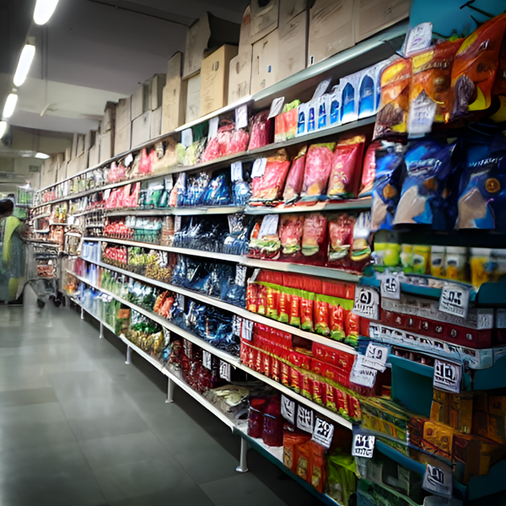
Resume Challenge 9
FMGC
SALE’S
PROMOTION
-by Pushkar Khare

Slide 2
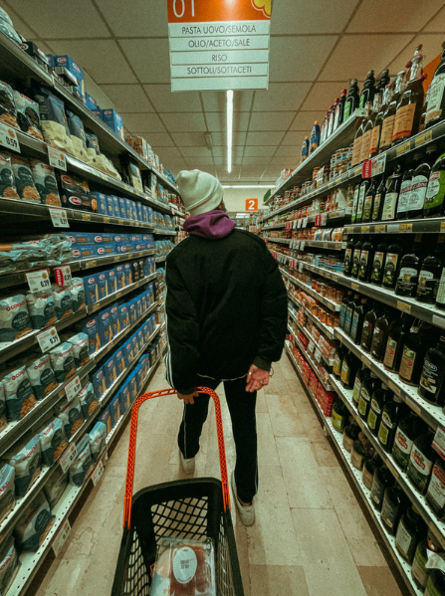




About
AtliQ Mart is a big store chain with more than 50 supermarkets in the South of India.
objective
During Diwali and Sankranti in 2024, all 50 stores had a big sale on their AtliQ products.
Now, the boss wants to decide what to do for the next sale event.

Slide 3
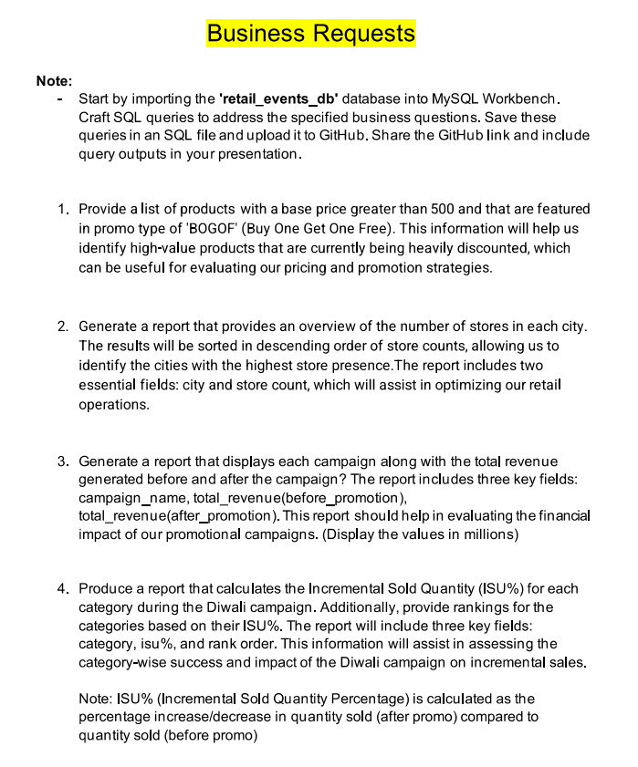
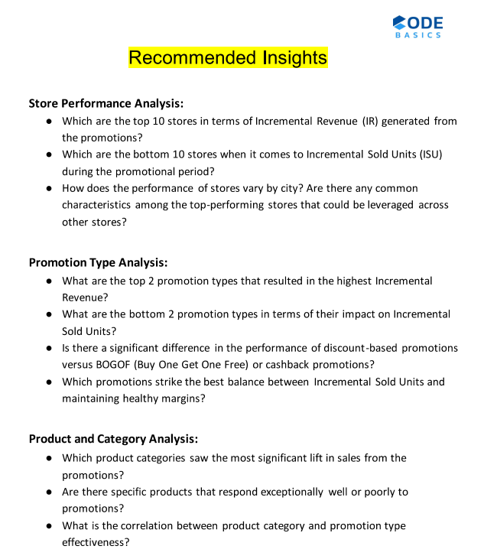

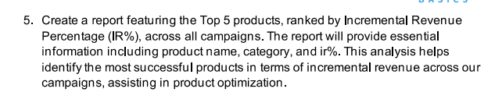
Adhoc - Request
Recommendations

Slide 4
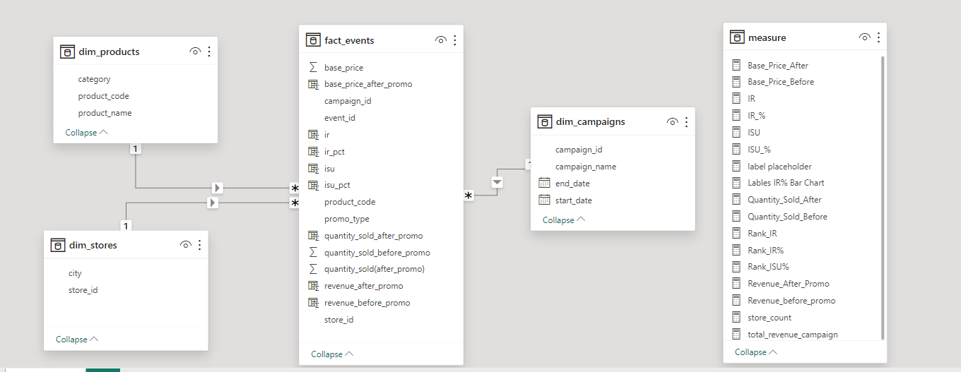


Er - Model
dimension table :
1) dim_product
2) dim_stores
3) dim_campaigns
fact_table :
1) fact_events
tools used :

Slide 5
ADhoc Insights

Slide 6
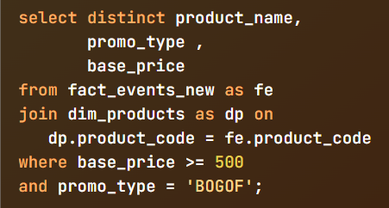

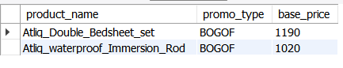
1 ) Provide a list of products with a base price greater than 500
and that are featured in promo type of 'BOGOF'

Slide 7
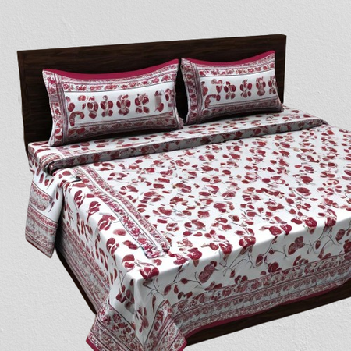
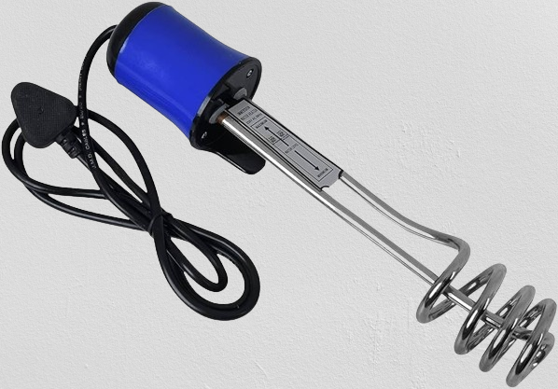
ATLIQ_DOUBLE_BEDSHEET_SET
ATLIQ_WATERPROOF_IMMERSION_ROD
BASE PRICE
BASE PRICE
1190
1020

Slide 8
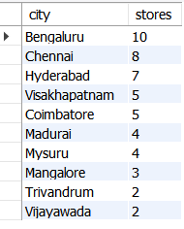
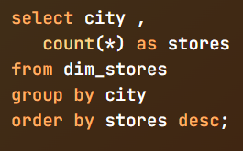
2) Generate a report that provides an overview of the number of stores in each city

Slide 9


Chennai and Hyderabad have 8 and 7 stores, respectively, behind Bangaluru's 10 stores
The lowest number of stores can be found in Trivandrum and Vijaywada with each having two

Slide 10
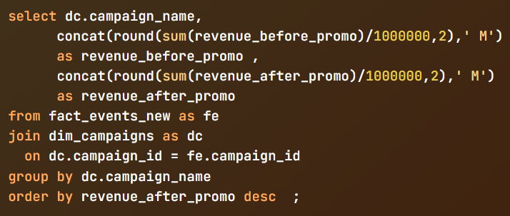
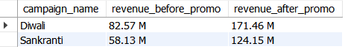
3) Generate a report detailing each campaign and its respective revenue before and after promotion

Slide 11
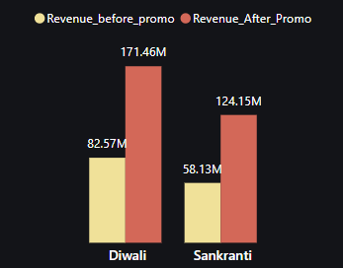
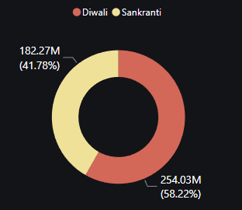
Diwali and Sankranti both saw a rise in revenue after promotion, with increases of 171 M and 124M
Diwali generated more revenue than Sankranti with a contribution of 58.2% of the total revenue.

Slide 12
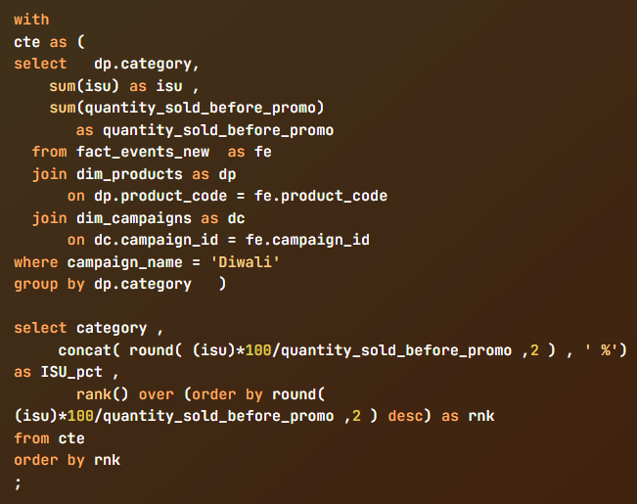
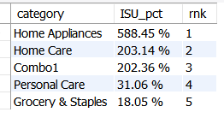
4) Produce a report that calculates the Incremental Sold Quantity (ISU%)
for each category during the Diwali campaign

Slide 13
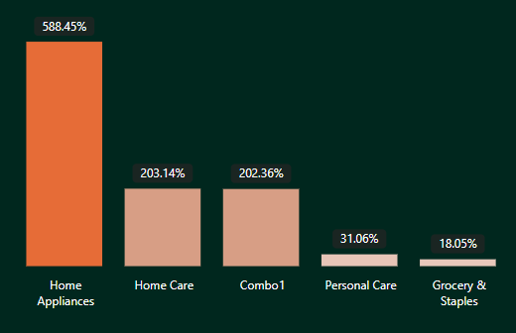
Incremental Sold Quantity (ISU%) Measures the percentage increase in product sales attributed to a specific campaign or promotion compared to pre-promotion levels.
Formula :
ISU% = (Incremental Sold Units / Quantity Sold Before Promotion) * 100.
Higher ISU% indicates more effective promotions in driving additional sales.
Home Appliances achieved the highest ISU% at 588.45%, indicating significant sales increases during Diwali promotions.
Categories such as Personal Care and Grocery & Staples show lower ISU%, highlighting opportunities for optimizing promotional strategies to improve sales outcomes.

Slide 14
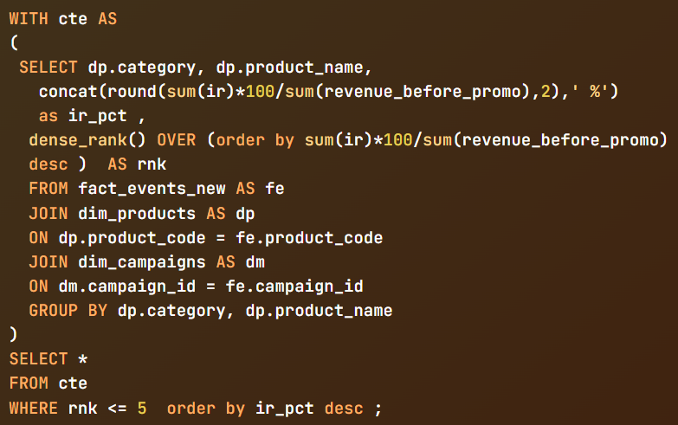
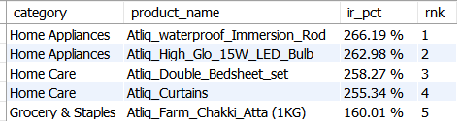
5) Report featuring the Top 5 products, ranked by Incremental Revenue Percentage (IR%)

Slide 15
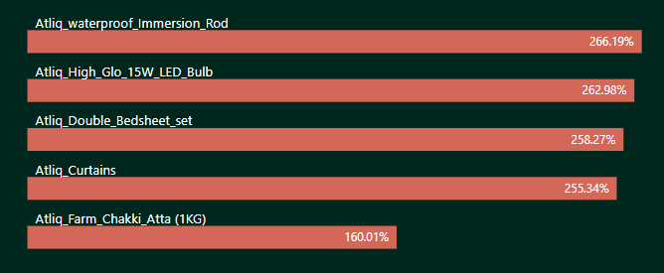
IR% (Incremental Revenue Percentage): Shows the percentage rise in product revenue after a promotion compared to before.
Formula:
IR% = ((Quantity Sold After Promo * Base Price) - (Quantity Sold Before Promo * Base Price)) / (Quantity Sold Before Promo * Base Price) * 100.
query calculates IR% for products across campaigns and categories, ranking them based on their revenue impact post-promotion.
Top Sellers: Atliq_waterproof_Immersion_Rod, Atliq_High_Glo_15W_LED_Bulb, Atliq_Double_Bedsheet_set, and Atliq_Curtains drive the most revenue growth.
Varying Impact: Revenue increases differ across product categories.
Customer Picks: High IR% items reveal customer preferences during promotions.

Slide 16
Store Performance Analysis

Slide 17
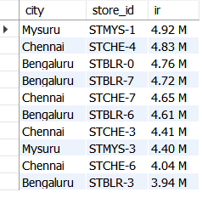
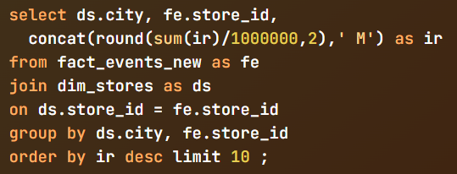
1) Top 10 stores in terms of Incremental Revenue (IR)

Slide 18
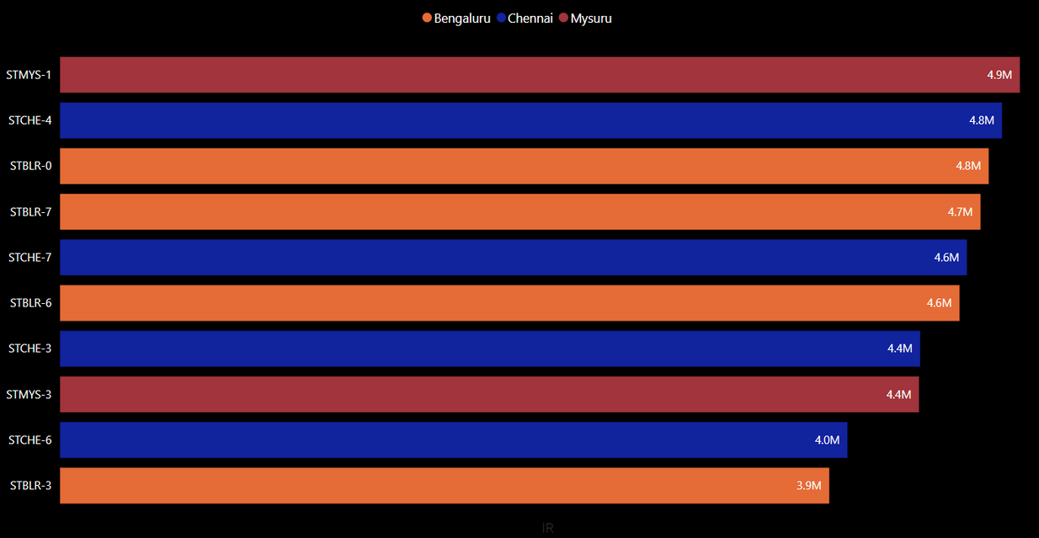
Most of the top 10 stores are in Bengaluru and Chennai, with four in each city. Mysuru also has two stores, making it stand out.
The store in Mysuru had the highest IR, making 4.92 million.

Slide 19
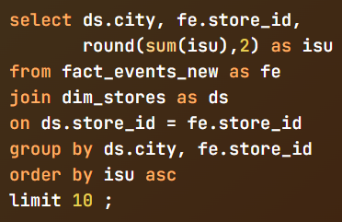
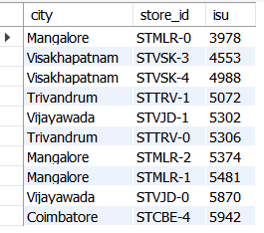
2) Bottom 10 stores when it comes to Incremental Sold Units (ISU)

Slide 20
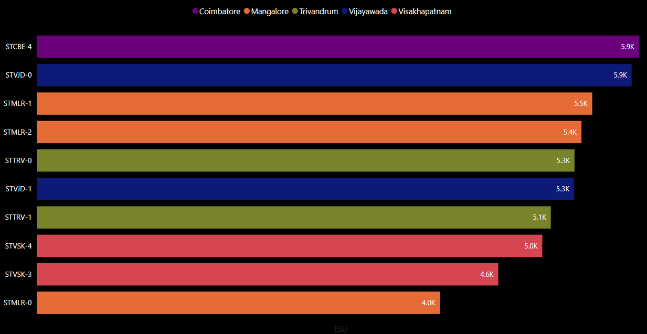
Stores in Mangalore, Visakhapatnam, Trivandrum, Vijayawada, and Coimbatore had the lowest ISU during the promotional period.
The lowest-performing store (STMLR-0) sold only 3978 units during the promotion.
There's a notable difference in ISU between the top and bottom stores, indicating varying effectiveness in driving sales during the promotion.

Slide 21
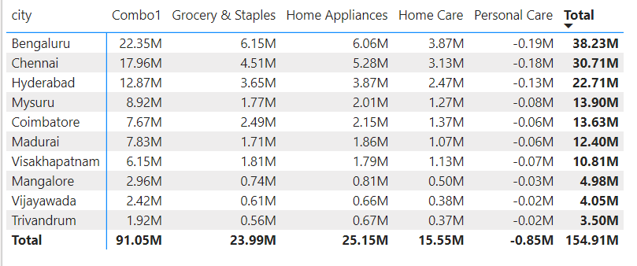
3) How does the performance of stores vary by city? Are there any common characteristics among the top-performing stores that could be leveraged across other stores?
The categories "Combo1" and "Grocery & Staples" consistently demonstrate top performance, with Incremental Revenue (IR) reaching 91 million and 23 million respectively.
Revenue Increment varies significantly across cities, with Bengaluru and Chennai leading the way, while Vijayawada and Trivandrum lag behind in their contributions.

Slide 22

Strategies To Boost Performance For Stores
Focus on Popular Products:
Top stores earned the most from products like Combo1 and Grocery Staples, which are always in demand.
Smart Promotions:
Successful stores may use local promotions that match what people in each city like.
Great Customer Service:
Top stores might focus on being really nice to customers, making the store a nice place to be, and making it easy for customers to shop again.

Slide 23
Promotion Analysis

Slide 24
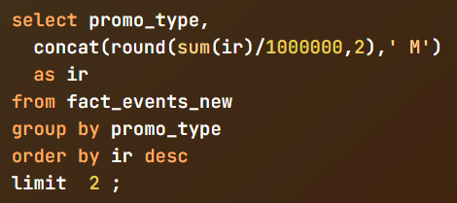
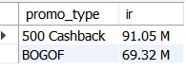
1) The top 2 promotion types that resulted in the highest Incremental Revenue

Slide 25
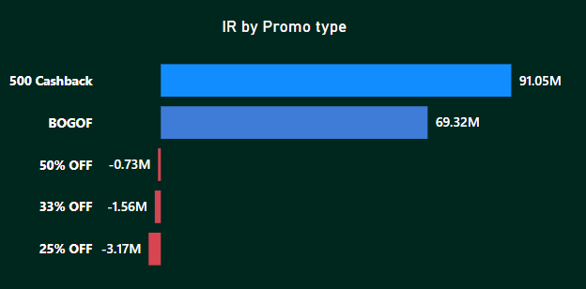
"500 Cashback" and "BOGOF" promotions emerge as top performers, generating the highest Incremental Revenue of 91.05 M and 69.32 M respectively.
Conversely, promotions like "25% OFF," "33% OFF," and "50% OFF" resulted in negative Incremental Revenue, indicating losses during the promotional period.

Slide 26
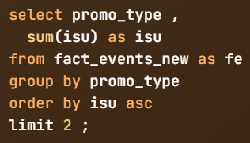
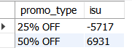
2) The bottom 2 promotion types in terms of their impact on Incremental Sold Units

Slide 27
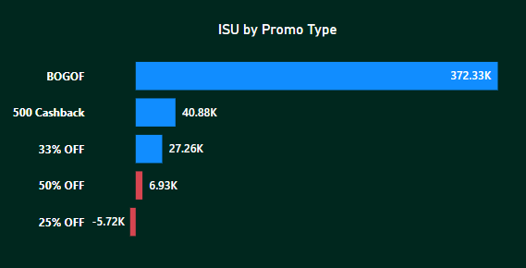

"25% OFF" and "50% OFF" promotions resulted in the weakest sales uplift, with "25% OFF" even causing a decrease in sales ( - 5771 units ).
"BOGOF" promotions led in sales, increasing by 372,326 units, while "500 Cashback" promotions followed closely with a boost of 40,881 units.

Slide 28
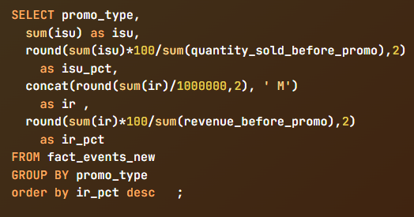
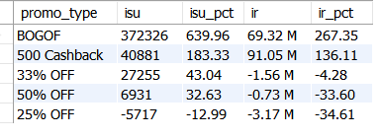
3) Is there a significant difference in the performance of discount-based promotions versus BOGOF (Buy One Get One Free) or cashback promotions
BOGOF and 500 Cashback promotions significantly outperform discount-based promotions in terms of Incremental Sold Units (ISU) and Incremental Revenue (IR).
In contrast, discount-based promotions such as 33% OFF, 50% OFF, and 25% OFF resulted in negative IR.
These promotions not only failed to generate additional revenue but also incurred losses during the promotional period.
The data suggests that the type of promotion significantly influences both ISU and IR metrics

Slide 29
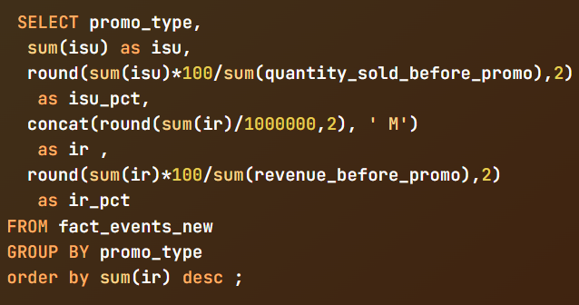
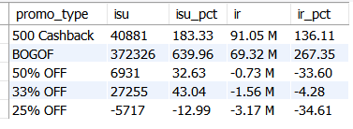
4) Which promotions strike the best balance between Incremental Sold Units
and maintaining healthy margins

Slide 30
"500 Cashback" and "BOGOF" promotions balance Incremental Sold Units (ISU) and maintain healthy margins.
Despite "500 Cashback" having lower ISU than "BOGOF," it sustains healthy margins with an Incremental Revenue (IR) percentage of 136.11%, while "BOGOF" promotions maintain strong margins with an IR percentage of 267.35%.
Conversely, "50% OFF," "33% OFF," and "25% OFF" promotions struggle with lower ISU percentages and negative IR percentages, posing challenges in maintaining healthy margins while driving sales.

Slide 31
Product and Category Analysis

Slide 32
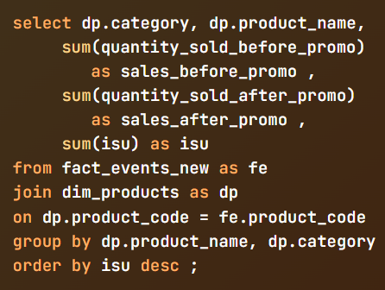
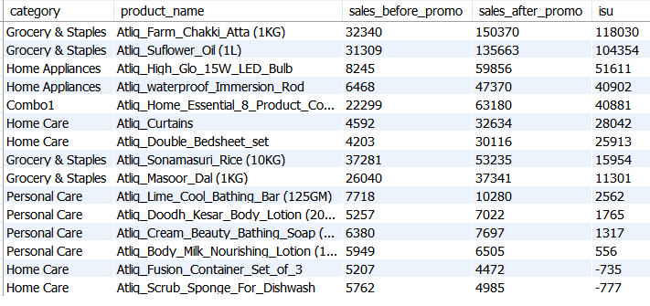
1) which product categories saw the most significant lift in sales from the promotions

Slide 33
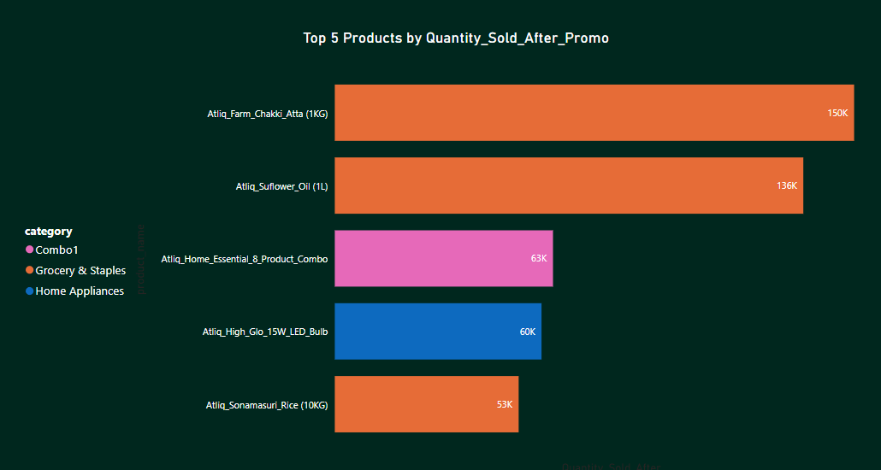
Combo , Grocery & and Home Appliances had products that were the top seller after promotion
Atliq Farm Chakki Atta was the top product sold with isu of 118k units
Home Care was the lowest performing category which saw the decrease in sales of its products after promotion with negative isu

Slide 34
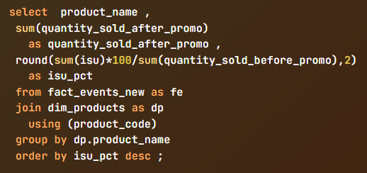
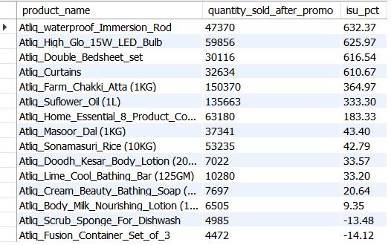
2) Are there any products that respond expectionally well or poorly to promotions

Slide 35
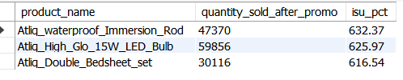
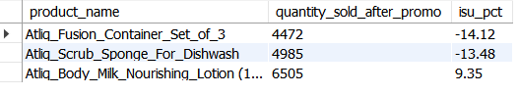
Top Products
Bottom Products
Atliq_waterproof_Immersion_Rod and Atliq_High_Glo_15W_LED_Bulb experienced remarkable sales increases post-promotion, indicating strong customer response to promotional offers.
Atliq_Fusion_Container_Set_of_3 and Atliq_Scrub_Sponge_For_Dishwash experienced declines in sales after the promotion, indicating that the promotional offers may have been less appealing to customers

Slide 36
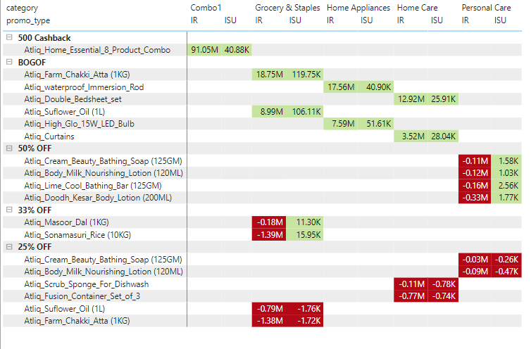
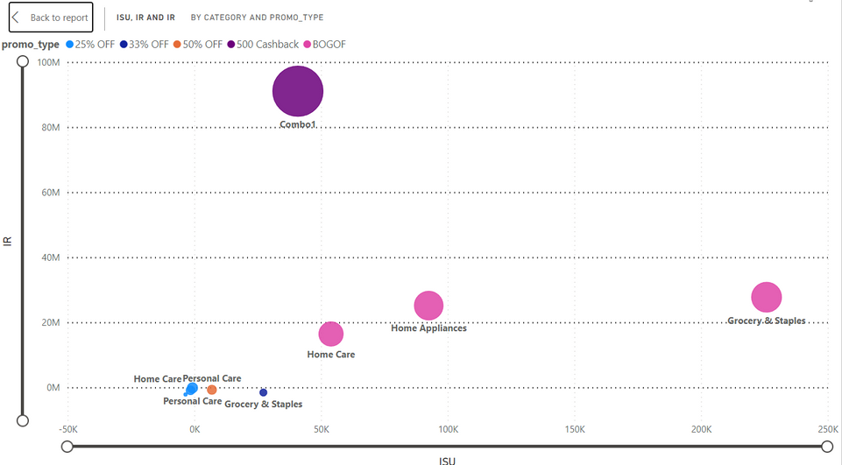
3) What is the correlation between product category and promotion type effectivness
“BOGOF” and “500 Cashback” shows positive relation with all categories
“50% off” & “35% off” are not performing well and shows negative IR
Promotion “25 % Off” has negative correlation with every category it show loss in both sales and revenue

Slide 37


thank you!

